Slide 1
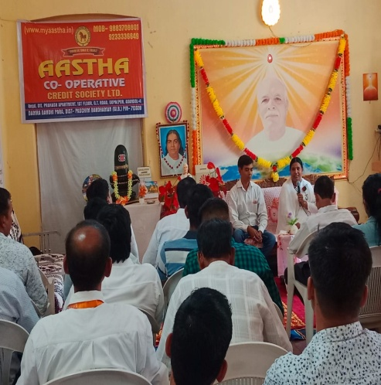
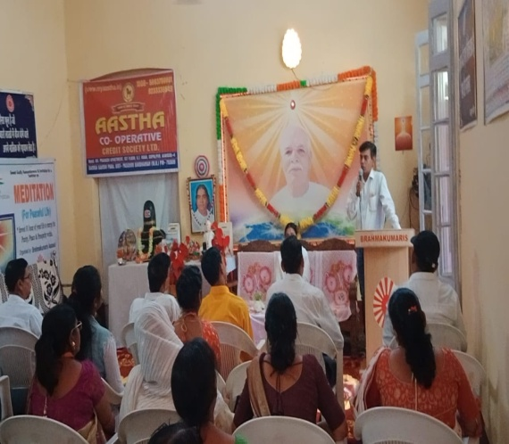
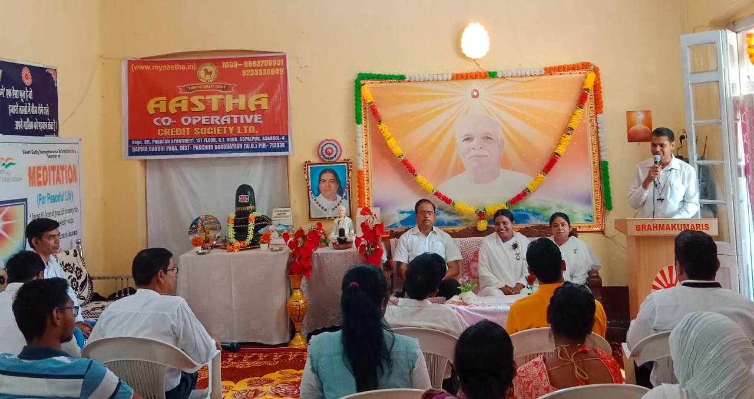
Asansol : Aastha Co-Operative Credit Society Ltd. And Brahmakumaris Asansol Sevakendra ki aur se Banking Seva me jure logo ke l iye Rajyoga se lav karyakram ka ayojan 1/ 04/2024 ko kiya gaya.is absar par Mukhya Atithi Mr. Santanu Sarkar, Managing Director, Aastha Co-Operative Credit Society Ltd. And Mr. Animesh Das, Councillor & Borough Chairman, Asansol

