Slide 1
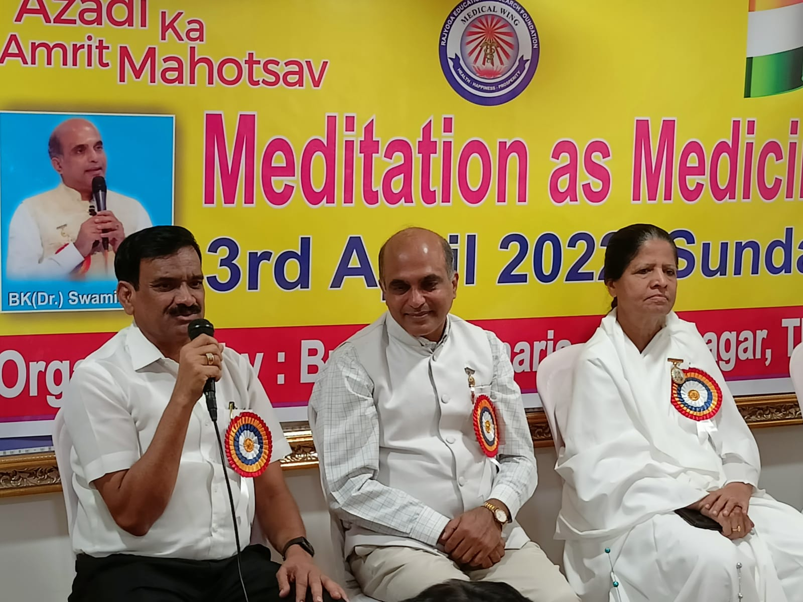
Meditation as Medicine
Panel on stage Dr Bhor , Dr E V Swaminath bhai & BK Seeta Ben(Center in charge)

Slide 2
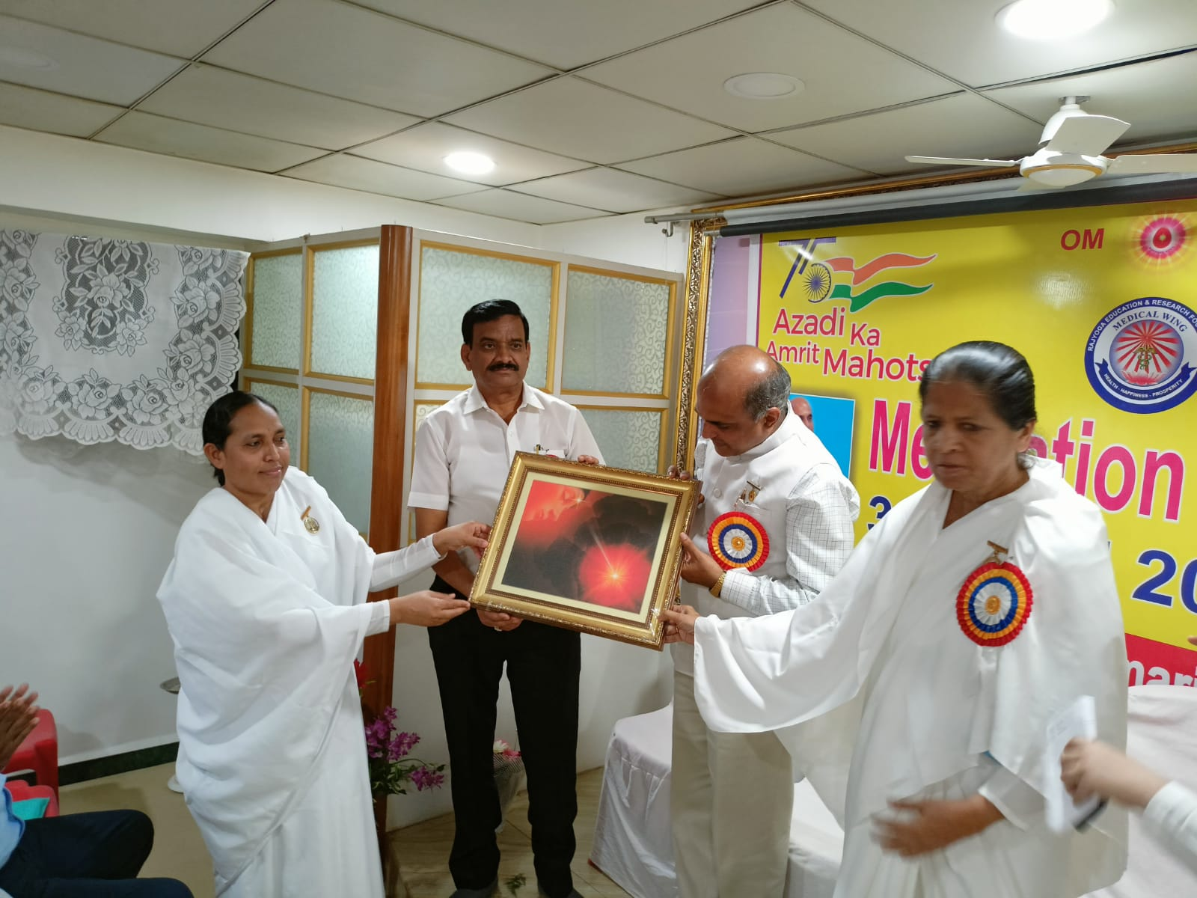
Meditation as Medicine
Giving Godly Gift Dr Bhor

Slide 3
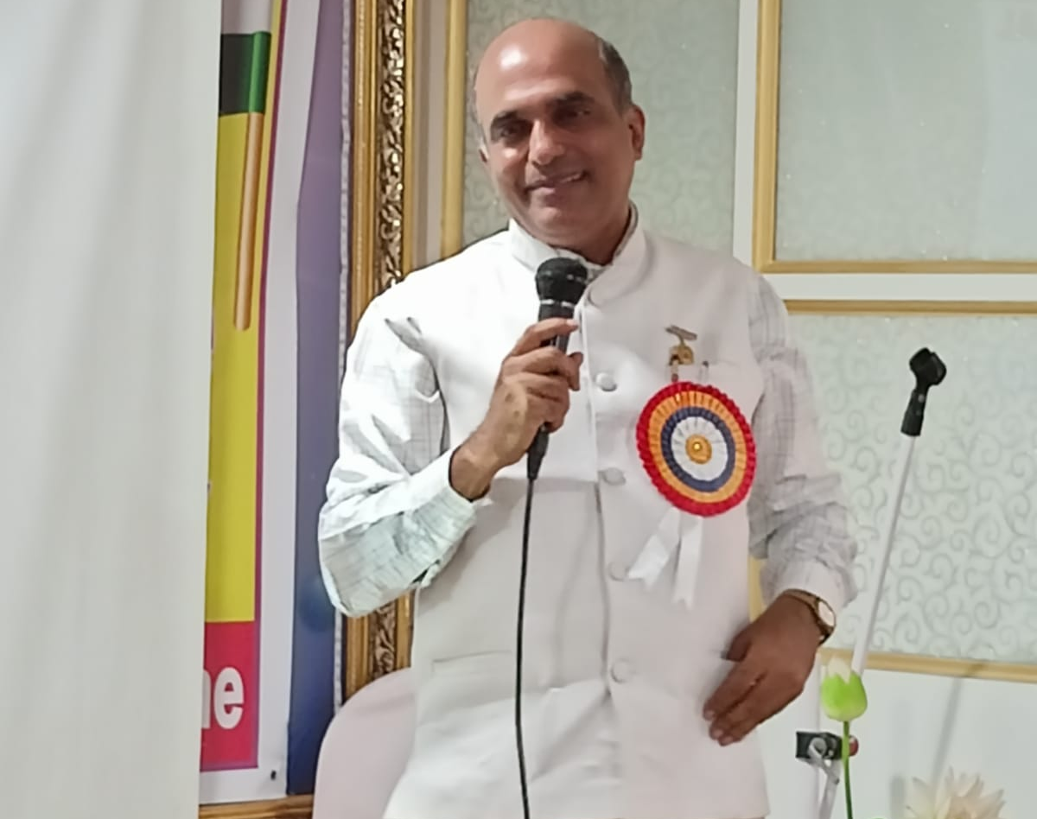
Meditation as Medicine
Lecture by Dr EV Swaminath

Slide 4
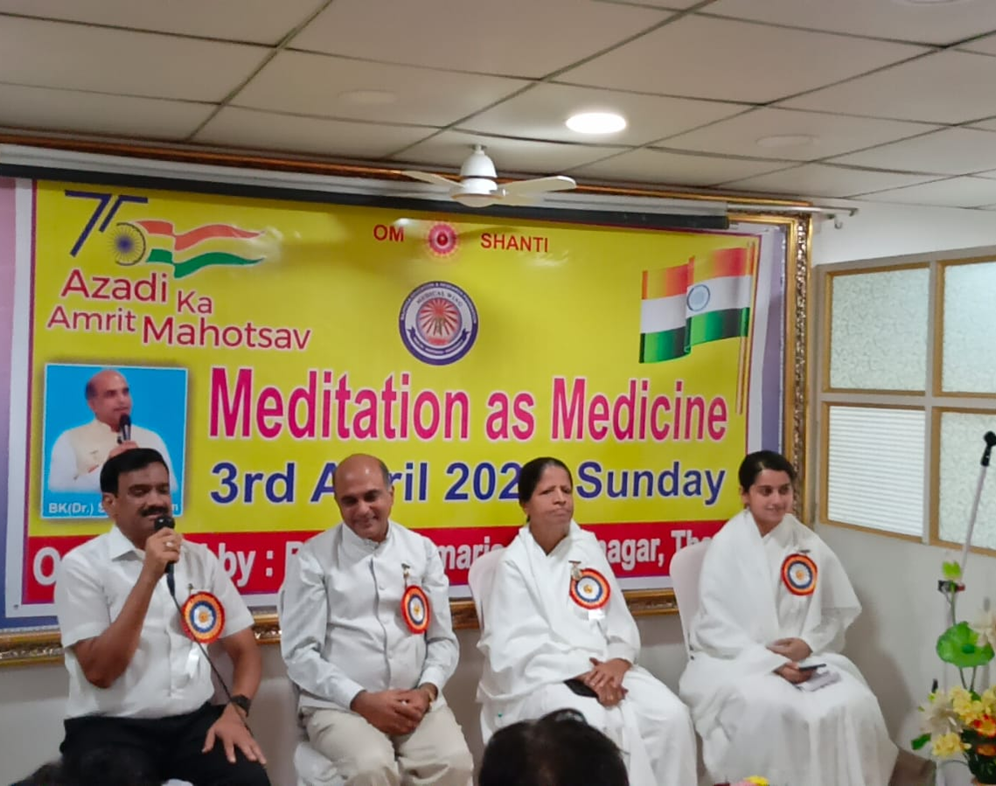
Meditation as Medicine
Panel on stage from Left Dr Bhor, Dr EV Swaminath, BK Seeta Behen & BK Ashwini Tilak

Slide 5
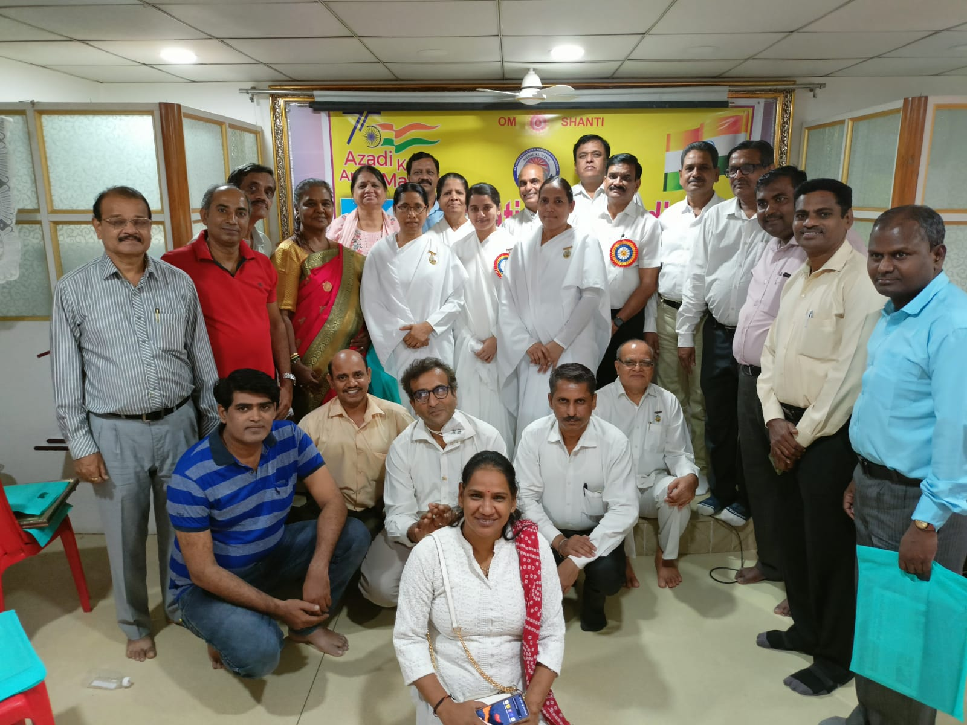
Meditation as Medicine
All Wagle Estate Association Group Photo

Slide 6
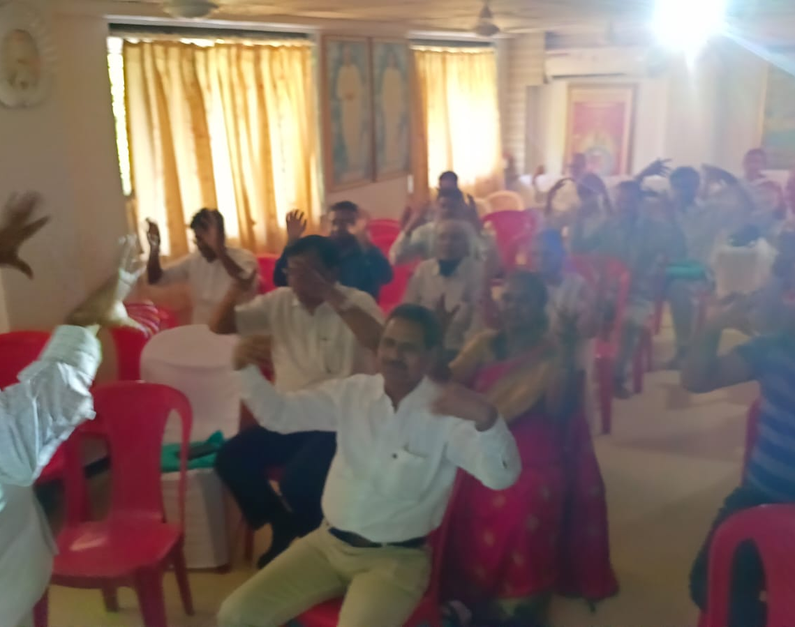
Meditation as Medicine
Relaxation Games for Drs

Slide 7
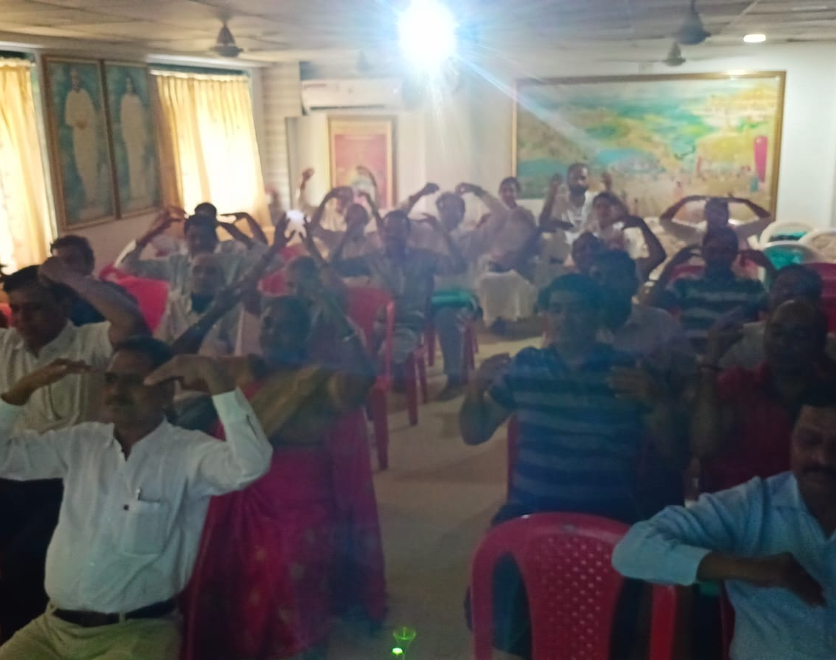
Meditation as Medicine

