Slide 1
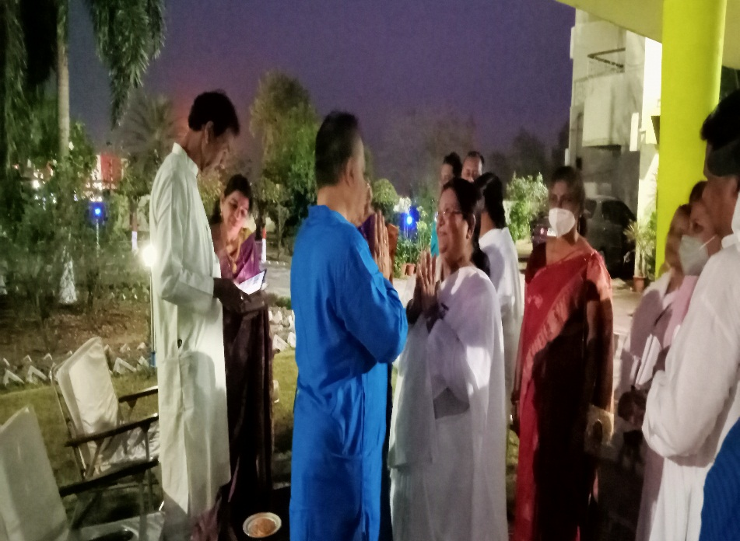
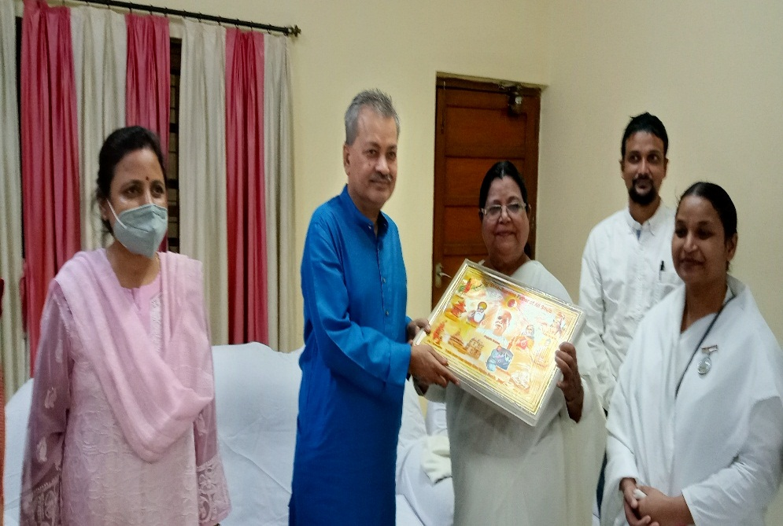
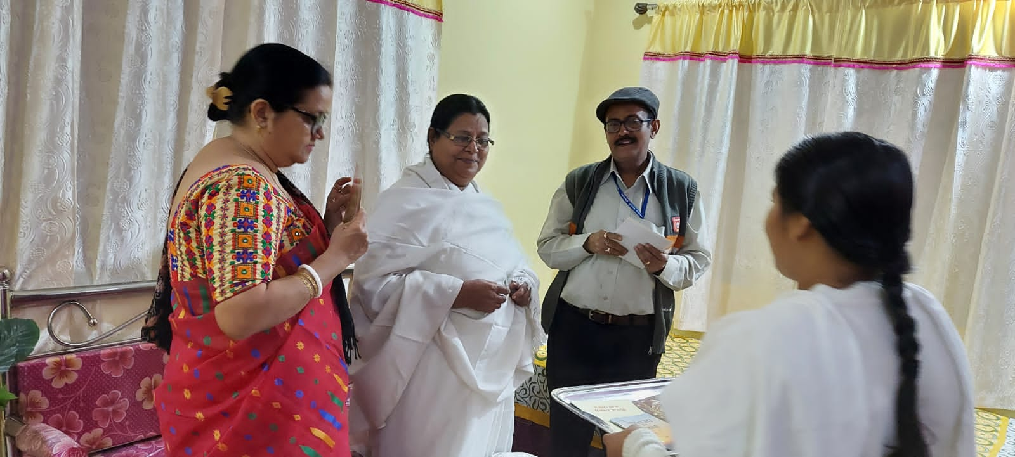
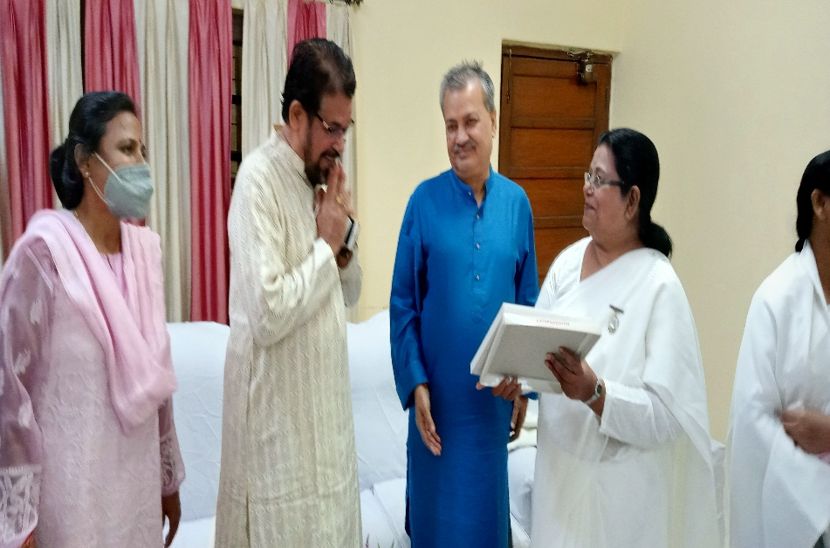
Maithon – Visit Chairman, R. N. Singh, Damodhar Valley Corporation. And Project Head , Debasis Datta, Damodar Valley Corporation Maithon Damp.

